Slide 1

Life Span Development
CHAPTER 7

Slide 2
National EMS Education Standard Competencies (1 of 2)
Preparatory
Applies fundamental knowledge of the emergency medical services (EMS) system; safety/well-being of the emergency medical technician (EMT), medical/legal, and ethical issues to the provision of emergency care.
Notes:
National EMS Education Standard Competencies
Preparatory
Applies fundamental knowledge of the emergency medical services (EMS) system, safety/well-being of the emergency medical technician (EMT), medical/legal, and ethical issues to the provision of emergency care.

Slide 3
National EMS Education Standard Competencies (2 of 2)
Life Span Development
Applies fundamental knowledge of life span development to patient assessment and management.
Notes:
National EMS Education Standard Competencies
Life Span Development
Applies fundamental knowledge of life span development to patient assessment and management.

Slide 4
Introduction
Humans develop throughout their lives.
EMTs must be aware of the physical changes a person undergoes at various stages of life.
  May affect the approach to patient care
Notes:
Lecture Outline
I. Introduction
A. Humans develop throughout their lives.
B. EMTs must be aware of the physical changes a person undergoes at various stages of life.
1. They may alter the approach to patient care.

Slide 5
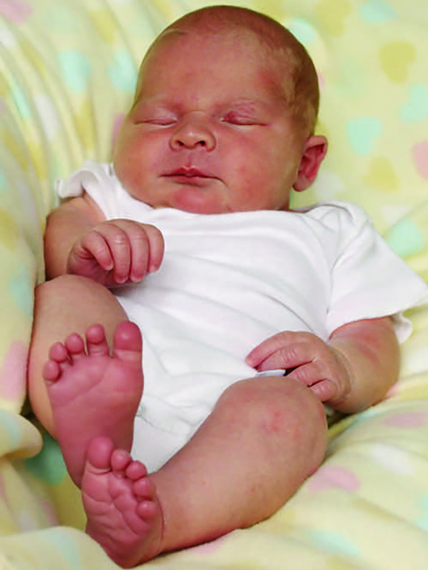
Neonates and Infants (1 of 11)
Neonates
  Birth to 1 month
Infants
  1 month to 1 year
  Develop at a startling rate
FIGURE 7-1 An infant is 1 month to 1 year of age.
© Johanna Goodyear/ShutterStock.
Notes:
Lecture Outline
II. Neonates and Infants
A. Neonates (birth to 1 month) are covered in Chapter 33, “Obstetrics and Neonatal Care.”
B. Infants (ages 1 month to 1 year) develop at a startling rate.

Slide 6
Neonates and Infants (2 of 11)
Weight
  Neonate weighs 6 to 8 lb (3 to 3.5 kg) at birth.
  The head accounts for 25% of body weight.
  Growth of about 1 oz per day
  Weight triples by the end of the first year
Notes:
Lecture Outline
1. Weight
a. A neonate usually weighs 6 to 8 lb (3 to 3.5 kg) at birth.
b. The head accounts for 25% of its body weight.
c. After week 2, infants grow at a rate of about 1 oz (30 g) per day, doubling their weight by 4 to 6 months and tripling it by the end of the first year.

Slide 7
Neonates and Infants (3 of 11)
Cardiovascular system
  At birth, neonate makes transition from fetal to independent circulation.
Pulmonary system
  Infants younger than 6 months are prone to nasal congestion.
  Infants have larger tongues and shorter, narrower airways, so airway obstruction is more common than in older children or adults.
Notes:
Lecture Outline
3. Cardiovascular system
a. At birth, the neonate makes the transition from fetal to independent circulation.
Pulmonary system
a. Prior to birth, a neonate’s lungs have never been inflated.
b. First breath is facilitated in part by the chest’s passage through the birth canal and increase in intrathoracic pressure.
c. Infants younger than 6 months are particularly prone to nasal congestion.
d. Infants have proportionately larger tongues and proportionally shorter, narrower airways, so airway obstruction is more common in infants.
e. The rib cage is less rigid and the ribs sit horizontally.
f. For bag-mask ventilation, remember that an infant’s lungs are fragile.
i. Forceful ventilations can result in trauma from pressure, or barotrauma.
g. Respiratory muscles are immature and there are fewer alveoli in the lungs.
i. Respiratory problems can quickly become life threatening.

Slide 8
Neonates and Infants (4 of 11)
Nervous system
  Evolution continues after birth.
  Moro reflex: neonate opens arms wide, spreads fingers, and seems to grab at things.
  Palmar grasp: occurs when an object is placed into the neonate’s palm
  Rooting reflex: neonate instinctively turns head when something touches its cheek.
  Sucking reflex: occurs when a neonate’s lips are stroked
Notes:
Lecture Outline
5. Nervous system
a. The nervous continues to evolve after birth.
b. A neonate is born with certain reflexes.
i. Moro reflex (startle reflex): when a neonate is caught off guard, it opens its arms wide, spreads its fingers, and seems to grab at things.
ii. Palmar grasp: occurs when an object is placed into the neonate’s palm
iii. Rooting reflex: when something touches a neonate’s cheek, it will turn its head toward the touch.
iv. Sucking reflex: occurs when a neonate’s lips are stroked

Slide 9
Neonates and Infants (5 of 11)
Fontanelles
  Spaces between the bones that eventually fuse to form the skull
  Posterior fontanelle fuses by 3 months.
  Anterior fontanelle fuses between age 9 and 18 months.
Notes:
Lecture Outline
c. A neonate’s fontanelles are the spaces between the bones that eventually fuse to form the skull.
i. The posterior fontanelle fuses by 3 months.
ii. The anterior fontanelle fuses between 9 and 18 months of age.
iii. A depressed fontanelle may indicate dehydration.
iv. A bulging fontanelle is indicative of increased intracranial pressure.

Slide 10
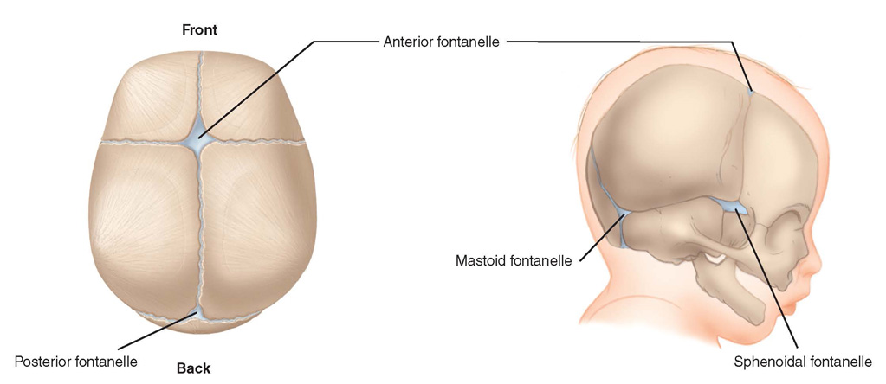
Neonates and Infants (6 of 11)
FIGURE 7-2 Fontanelles.
© Jones & Bartlett Learning.
Notes:
This figure shows the fontanelles on an infant’s head.

Slide 11
Neonates and Infants (7 of 11)
Nervous system (cont’d)
  2 months of age: tracking objects with their eyes and recognize familiar faces
  6 months of age: sitting upright and babbling
  12 months of age: walking with minimal assistance
Notes:
d. By 2 months of age, infants can track objects with their eyes and recognize familiar faces.
e. At 6 months, they can sit upright, and they begin to make cooing and babbling sounds.
f. By 12 months of age, an infant can walk with minimal assistance and knows his or her name.

Slide 12
Neonates and Infants (8 of 11)
Immune system
  Maintains some of the mother’s immunities
  Infants can also receive antibodies via breastfeeding.
Notes:
5. Immune system
a. The immune system maintains some of the mother’s immunities.
b. Infants can also receive antibodies via breastfeeding, further bolstering their immune system.

Slide 13
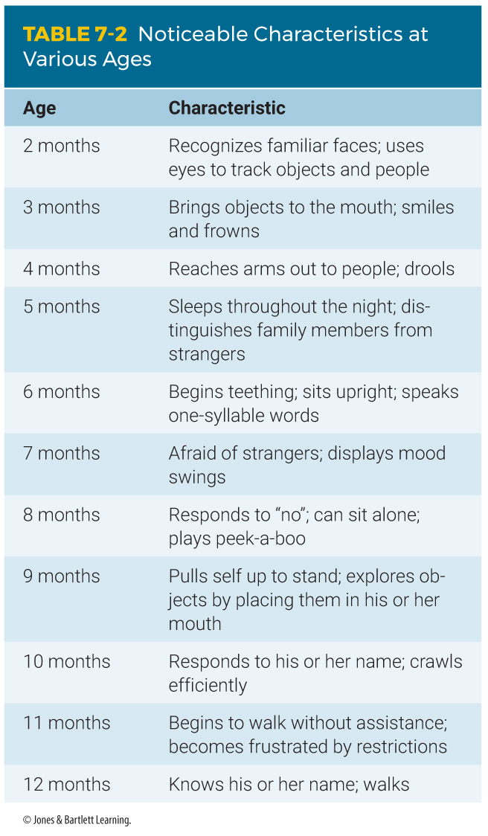
Neonates and Infants (9 of 11)
Psychosocial changes
  Begin at birth and evolve as the infant interacts with the environment
Notes:
Lecture Outline
D. Psychosocial changes
1. Begin at birth and evolve as the infant interacts with, and reacts to, the environment

Slide 14
Neonates and Infants (10 of 11)
Psychosocial changes (cont’d)
  Crying is the main method of communicating distress.
  Infants develop relationships with their parents or caregivers at different rates.
Notes:
Lecture Outline
2. Crying is the main method of communicating distress.

Slide 15
Neonates and Infants (11 of 11)
Psychosocial changes (cont’d)
  Bonding is based on a secure attachment.
  Anxious-avoidant attachment is found in infants who are repeatedly rejected.
  Separation anxiety is common in older infants.
  Trust and mistrust involves an infant’s needs being met.
Notes:
Lecture Outline
3. Bonding is based on a secure attachment.
a. Anxious-avoidant attachment is found in infants who are repeatedly rejected.
b. Children show little emotional response to their parents or caregivers and treat them as they would strangers.
4. Separation anxiety is common in older infants.
5. Trust and mistrust refers to a stage of development from birth to about 18 months, which involves an infant’s needs being met by his or her parents or caregivers.

Slide 16
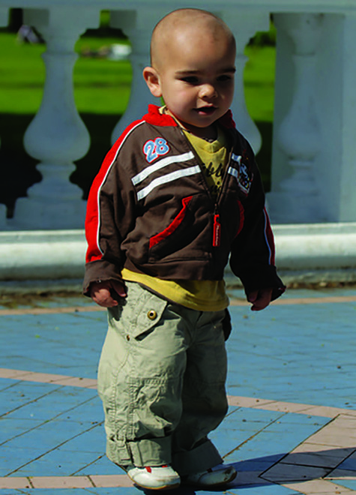
Toddlers and Preschoolers (1 of 4)
The cardiovascular system of a toddler (1 to 3 years) or preschooler (4 to 6 years) is not dramatically different from an adult.
FIGURE 7-4 A toddler is 1 to 3 years of age.
© EML/Shutterstock.
Notes:
Lecture Outline
III. Toddlers and Preschoolers
A. Physical changes
1. The cardiovascular system of a toddler (ages 1 to 3 years) or preschooler (ages 3 to 6 years) is not dramatically different from an adult.

Slide 17
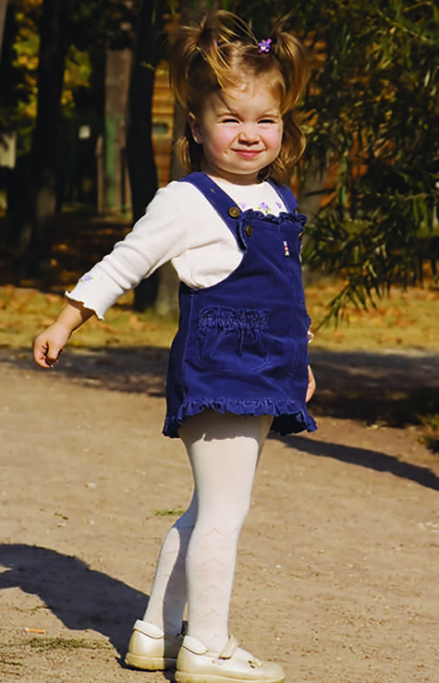
Toddlers and Preschoolers (2 of 4)
Preschoolers (3 to 6 years)
  Pulse: 80 to 140 beats/min
  Respiratory rate: 20 to 25 breaths/min
  Systolic blood pressure: 80 to 100 mm Hg
FIGURE 7-5 A preschooler is 3 to 6 years of age.
© Maxim Bolotnikov/Shutterstock.
Notes:
Lecture Outline
2. Preschoolers (ages 3 to 6 years)
a. Pulse rate is 80 to 140 beats/min.
b. Respiratory rate is 20 to 25 breaths/min.
c. Systolic blood pressure is 80 to 100 mm Hg.

Slide 18
Toddlers and Preschoolers (3 of 4)
Preschoolers (cont’d)
  Do not have well-developed lung musculature
  Weight gain should level off.
  Passive immunity is lost.
  Neuromuscular growth also makes considerable progress at this age.
  Average age for completion of toilet training is 28 months.
Notes:
Lecture Outline
2. Toddlers and preschoolers do not have well-developed lung musculature and are unable to sustain deep or rapid respirations for an extended period of time.
3. Weight gain should level off.
4. The loss of passive immunity is one of the most impactful physiologic change at this stage of human life.
5. Neuromuscular growth makes considerable progress at this age.
6. Toilet training is usually completed around 28 months of age.

Slide 19
Toddlers and Preschoolers (4 of 4)
Psychosocial changes
  Learn to speak and express themselves
  Master basic language
  Interact and play games with other children
  Begin to understand cause and effect
  Learn to recognize gender differences by observing role models
Notes:
Lecture Outline
B. Psychosocial changes
1. The psychosocial challenge for this age group is sometimes referred to as autonomy versus shame and doubt.
2. At 36 months of age, basic language is mastered.
3. Interaction and playing games with other children begin.
4. By 18 to 24 months, cause and effect begin to become understood.
5. Children learn to recognize gender differences by observing role models.

Slide 20

School-Age Children (1 of 3)
6 to 12 years
Physical traits and functions continue to mature at a rapid rate
FIGURE 7-7 A school-age child is 6 to 12 years of age.
© Trout55/Shutterstock.
Notes:
Lecture Outline
IV. School-Age Children
A. Physical changes
1. From ages 6 to 12 years, a school-age child’s physical traits and functions continue to mature at a rapid rate.

Slide 21
School-Age Children (2 of 3)
Growth of 4 lb and 2.5 inches each year
Permanent teeth come in.
Brain activity increases in both hemispheres.
Notes:
Lecture Outline
2. Growth of 4 lb (2 kg) and 2.5 inches (6 cm) each year
3. Permanent teeth come in.
4. Brain activity increases in both hemispheres.

Slide 22
School-Age Children (3 of 3)
Psychosocial changes
  Preconventional reasoning: children act to avoid punishment and get what they want.
  Conventional reasoning: children look for approval from peers and society.
  Postconventional reasoning: children make decisions guided by their conscience.
  Self-concept and self-esteem develop.
Notes:
Lecture Outline
B. Psychosocial changes
1. Children learn various types of reasoning.
a. Preconventional reasoning: children act almost purely to avoid punishment and get what they want.
b. Conventional reasoning: children look for approval from their peers and society.
c. Postconventional reasoning: children make decisions guided by their conscience.
2. Children begin to develop their self-concept and self-esteem.

Slide 23

Adolescents (Teenagers) (1 of 4)
12 to 18 years
Vital signs level off.
  Pulse: 60 to 100 beats/min
  Respirations: 12 to 20 breaths/min
  Systolic blood pressure: 90 to 110 mm Hg
FIGURE 7-8 An adolescent is 12 to 18 years of age.
© Jamie Wilson/Shutterstock.
Notes:
Lecture Outline
V. Adolescents (Teenagers)
A. Physical changes
1. In adolescents (ages 12 to 18 years), vital signs begin to level off within the adult ranges.
a. Pulse rate is 60 to 100 beats/min.
b. Respiratory rate is 12 to 20 breaths/min.
c. Systolic blood pressure is between 90 and 110 mm Hg.

Slide 24
Adolescents (Teenagers) (2 of 4)
2- to 3-year growth spurt
  Girls finish by 16 years; boys by 18 years.
Reproductive system matures.
  Secondary sexual development takes place.
  Voices start to change.
  Menstruation begins.
  Acne can occur.
Notes:
Lecture Outline
2. Adolescents experience a 2- to 3-year growth spurt (an increase in muscle and bone growth) and body changes.
a. Girls generally finish their growth spurt by 16 years and boys by 18 years.
3. The endocrine and reproductive system matures, and secondary sexual development takes place
a. Pubic hair and axillary hair begin to appear.
b. Voices start to change.
c. Menstruation begins.

Slide 25
Adolescents (Teenagers) (3 of 4)
Psychosocial changes
  Adolescents and their families often deal with conflict.
  Privacy becomes an issue.
  Self-consciousness increases.
  Adolescents may struggle to create their own identity.
Notes:
Lecture Outline
Psychosocial changes
1. Adolescents and their families often deal with conflict as adolescents try to gain control of their lives from their parents.
a. Privacy becomes an issue.
b. Self-consciousness increases.
2. Adolescents may struggle to create their own identity.
a. Multiple options for gender exist
b. Many are fixated on their public image
3. They often want to be treated like adults yet cared for like younger children.

Slide 26
Adolescents (Teenagers) (4 of 4)
Psychosocial changes (cont’d)
  Antisocial behavior and peer pressure peak at age 14 to 16 years.
    Smoking, illicit drug use, unprotected sex
    Eating disorders
  Code of ethics develops.
  High risk of suicide and depression
Notes:
Lecture Outline
4. Antisocial behavior and peer pressure tend to peak at age 14 to 16 years.
a. Smoking, illicit drug use, and unprotected sex are problems that may arise.
b. Eating disorders can arise in adolescents from an attempt to gain self-control through what they eat.
5. A code of personal ethics develops, based partly on parents’ ethics and values and partly by their peers and personal experience.
6. Adolescents have a high risk for suicide and depression.

Slide 27

Early Adults (1 of 2)
19 to 40 years
Vital signs do not vary greatly.
  Pulse: 60 to 100 beats/min
  Respiratory rate: 12 to 20 breaths/min
  Systolic blood pressure: 90 to 120 mm Hg
FIGURE 7-10 An early adult is 19 to 40 years of age.
© Rubberball Productions.
Notes:
Lecture Outline
VI. Early Adults
A. Early adults range in age from 19 to 40 years.
B. Physical changes
1. Their vital signs do not vary greatly from those seen through adulthood.
a. Pulse rate will average around 70 beats/min and range between 60 and 100 beats/min.
b. Respiratory rate will stay in the range of 12 to 20 breaths/min.
c. Systolic blood pressure will be between 90 and 120 mm Hg.

Slide 28
Early Adults (2 of 2)
From age 19 to 25 years, the body should be functioning at its optimal level.
  Lifelong habits are solidified.
Psychosocial changes
  Life centers on work, family, and stress.
  Settling down, marriage, and family
  One of the more stable periods of life
Notes:
Lecture Outline
2. From age 19 years to shortly after 25 years, the body should be functioning at its optimal level.
a. Lifelong habits are solidified.
b. The body is working at peak efficiency, but, in the latter years of early adulthood, the effects of aging gradually become evident.
C. Psychosocial changes
1. Life centers on work, family, and stress.
2. During this period, adults strive to create a place for themselves in the world, and many do everything they can to “settle down.”
3. Despite the amount of stress and change, this is one of the more stable periods of life.

Slide 29

Middle Adults (1 of 3)
41 to 60 years
Vital signs remain the same.
  Pulse: 60 to 100 beats/min
  Respiratory rate: 12 to 20 breaths/min
  Systolic blood pressure: 90 to 140 mm Hg
FIGURE 7-11 A middle adult is 41 to 60 years of age.
© Photodisc.
Notes:
Lecture Outline
VII. Middle Adults
A. Middle adults are ages 41 to 60 years.
B. Physical changes
1. Vital signs remain the same.

Slide 30
Middle Adults (2 of 3)
Vulnerable to vision and hearing loss
Cancer incidence increases.
Menopause occurs in late 40s or early 50s.
Diabetes, hypertension, and weight problems are common.
Exercise and healthy diet can diminish the effects of aging.
Notes:
Lecture Outline
2. Middle adults are vulnerable to vision and hearing loss.
3. Cardiovascular health becomes an issue.
4. Cancer incidence increases.
5. Menopause takes place in the late 40s or early 50s.
6. Diabetes, hypertension, and weight problems are common.
7. Exercise and a healthy diet can diminish the effects of aging.

Slide 31
Middle Adults (3 of 3)
Psychosocial changes
  Focus on achieving life goals
  Readjust lifestyle as children leave home
  Generally have the physical, emotional, and spiritual reserves to handle life’s issues
  Finances become a concern.
  May be caring for both children leaving for college and aging parents
Notes:
Lecture Outline
C. Psychosocial changes
1. Focus is on achieving life goals.
2. Middle adults must readjust their lifestyle as children leave home.
3. Finances become a worrisome issue.
4. Generally, people of this age have the physical, emotional, and spiritual reserves to handle life’s issues.
5. Middle adults may find themselves caring for children leaving for college and caring for their aging parents as well.

Slide 32

Older Adults (1 of 13)
61 years and older
Life expectancy is constantly changing.
  Now approximately 78 years
FIGURE 7-12 An older adult is 61 years of age or older.
© Photodisc.
Notes:
Lecture Outline
VIII. Older Adults
A. Older adults include those ages 61 years and up.
B. Physical changes
1. Life expectancy is constantly changing.
a. It is now approximately 78 years.
b. Determined in part by birth year and country of residence
c. They are often able to overcome numerous medical conditions but may need multiple medications.

Slide 33
Older Adults (2 of 13)
Cardiovascular system
  Declines with age largely due to atherosclerosis
  Heart rate and cardiac output decrease.
  Vascular system becomes stiff.
  Ability to produce replacement blood cells declines, as does blood volume.
Notes:
Lecture Outline
2. Cardiovascular system
a. Cardiac function declines with age largely due to atherosclerosis.
b. Heart rate and cardiac output decrease.
i. Cardiac output can no longer meet the demands of the body.
c. The vascular system becomes stiff.
i. The heart must work harder to overcome vascular resistance
d. The ability to produce replacement blood cells declines, as does the blood volume.

Slide 34
Older Adults (3 of 13)
Respiratory system
  Size of airway increases.
  Surface area of alveoli decreases.
  Natural elasticity of the lungs decreases.
    Breathing becomes more labor intensive.
Notes:
Lecture Outline
3. Respiratory system
a. The size of the airways increase, and the surface area of the alveoli decreases.
b. The natural elasticity and the strength of the intercostal muscles and diaphragm decreases.
i. Breathing becomes more labor intensive.

Slide 35
Older Adults (4 of 13)
Respiratory system (cont’d)
  Vital capacity decreases.
  Chest becomes more rigid and fragile.
  Cough and gag reflex diminish.
  Greater risk for aspiration and airway obstruction
  More susceptible to lung infections
Notes:
Lecture Outline
c. By age 75 years, the vital capacity may amount to only 50% of the vital capacity of a young adult.
d. The chest becomes more rigid and fragile.
e. Cough and gag reflexes diminish along with the ability to clear secretions.
i. Older adults are at a greater risk of aspiration and airway obstruction.
f. Smooth muscles of the lower airway weaken causing airway collapse on inhalation.
i. Produces inspirstory wheezing, lower flow rates, and air trapping in the alveoli.
g. Older adults are more susceptible to lung infections.

Slide 36
Older Adults (5 of 13)
Endocrine system
  Insulin production drops off.
  Metabolism decreases.
  The reproductive system changes to some extent.
Notes:
Lecture Outline
4. Endocrine system
a. Insulin production drops off and metabolism decreases.
b. The reproductive system changes to some extent.
i. Hormone production for both sexes gradually decreases as they age.
ii. Sexual desire may diminish with age but does not cease.

Slide 37
Older Adults (6 of 13)
Digestive system
  Taste sensations decrease.
  Saliva secretion decreases.
  Ability of the intestines to contract and move food diminishes.
  Gallstones become increasingly common.
  Anal sphincter changes can produce fecal incontinence.
Notes:
Lecture Outline
5. Digestive system
a. Changes in gastric and intestinal function may inhibit nutritional intake and utilization in older adults.
i. Tooth loss makes chewing difficult and taste sensations decrease.
b. Saliva secretion decreases, and this reduces the body’s ability to process complex carbohydrates.
c. The ability of the intestines to contract and move food diminishes.
d. Gastric acid secretion diminishes.
e. Gallstones become increasingly common.
f. Decreased elasticity of the anal sphincter causes fecal incontinence.

Slide 38
Older Adults (7 of 13)
Renal system
  Filtration function declines.
  Kidney mass decreases by 20%.
  Diminished blood flow to the kidneys
  Decreased ability to clear wastes from the body and ability to conserve fluids when needed
Notes:
Lecture Outline
6. Renal systems
a. The filtration function declines by 50% from age 20 to 90 years.
b. Kidney mass decreases 20% over the same span.
c. There is a in the blood supply to the kidneys.
d. There is a decreased ability to remove waste and to conserve fluids when needed.

Slide 39
Older Adults (8 of 13)
Nervous system
  Motor and sensory neural networks become slower.
  Neurons are lost but there is no loss of knowledge or skill.
  Sleep patterns change.
Notes:
Lecture Outline
7. Nervous system
a. The brain weight may shrink 10% to 20% by age 80 years.
i. Motor and sensory neural networks become slower.
b. Neurons are lost, but this does not mean there is not a loss of knowledge or skill.
c. Sleep patterns change.

Slide 40
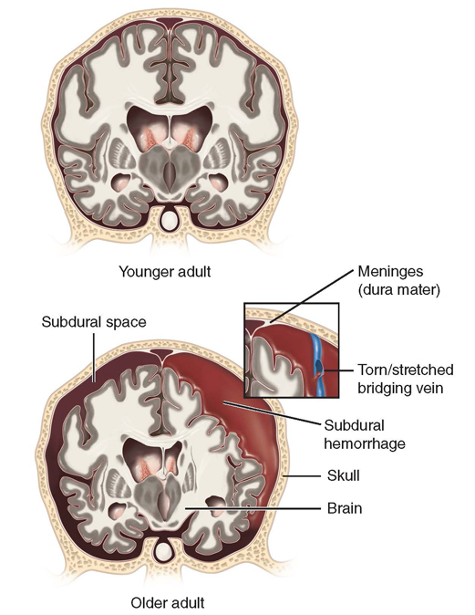
Older Adults (9 of 13)
Nervous system (cont’d)
  Age-related shrinkage creates a void between the brain and the outermost layer of the meninges.
FIGURE 7-14 Age-related atrophy or shrinkage of the brain
creates space between the brain and dura mater (subdural
space). When the bridging veins are stretched and torn,
blood may accumulate in this area.
© Jones & Bartlett Learning.
Notes:
Lecture Outline
d. Age-related shrinkage creates a void between the brain and the outermost layer of the meninges, which provides room for the brain to move when stressed.

Slide 41
Older Adults (10 of 13)
Nervous system (cont’d)
  Peripheral nerve sensation is diminished.
  Increased reaction times cause longer delays between stimulation and motion.
  Slowdown in reflexes and decreased kinesthetic sense may contribute to falls and trauma.
Notes:
Lecture Outline
e. Peripheral nerve slows with age.
i. Sensations become diminished and may be misinterpreted.
ii. Increased reaction times cause longer delays between stimulation and motion.
f. Prolonged reaction times and slower reflexes contribute to a higher incidence of falls.

Slide 42
Older Adults (11 of 13)
Sensory changes
  Most older adults can see and hear well.
  May need glasses or hearing aids
  Visual distortions are common.
  Hearing loss is four times more common than vision loss.
Notes:
Lecture Outline
8. Sensory changes
a. Pupillary reaction and ocular movements become more restricted.
b. Visual distortions are common.
c. Peripheral fields of vision narrow.
d. Hearing loss is four times more common than vision loss.
i. Loss of high-frequency hearing or deafness.

Slide 43
Older Adults (12 of 13)
Psychosocial changes
  Until about 5 years before death, most people retain high brain function.
  Statistics indicate that 95% of the elderly live at home.
  Financial limits may restrict access to health care or medications.
Notes:
Lecture Outline
C. Psychosocial changes
1. Until about 5 years before death, most people retain high brain function.
2. Statistics indicate that 95% of the elderly live at home.
a. May need assistance from family, friends, or home health care
3. Increased need for assisted-living facilities
4. Financial limits may restrict access to health care or medications.

Slide 44
Older Adults (13 of 13)
Psychosocial changes (cont’d)
  More than 50% of all single women in the United States who are 60 years of age or older are living at or below the poverty line.
  Elderly need to face their own mortality.
  Isolation and depression can be challenges.
Notes:
Lecture Outline
a. Today, more than 50% of all single women in the United States who are 60 years of age or older are living at or below the poverty level.
4. One of the important issues that the elderly need to face is their own mortality.
a. Isolation and depression can be challenges.

Slide 45
Review
When providing bag-mask ventilations to an infant, what is most important to remember?
  Blood pressure typically increases with age.
  An infant’s lungs are fragile.
  An infant grows at a rate of about 30 g per day.
  An infant has a proportionately larger tongue than an adult.

Slide 46
Review
Answer: B
Rationale: It is important to remember that an infant’s lungs are fragile; ventilations that are too forceful can result in trauma from pressure, or barotrauma. Due to the large size of the infant’s occiput and the increased flexibility of the trachea, the airway can easily be inadvertently occluded by incorrect positioning, either overextension or overflexion.

Slide 47
Review
When providing bag-mask ventilations to an infant, what is most important to remember?
  Blood pressure typically increases with age.
  Rationale: This is not crucial information when giving ventilations.
  An infant’s lungs are fragile.
  Rationale: Correct answer
  An infant grows at a rate of about 30 g per day.
  Rationale: This is not crucial information when giving ventilations.
  An infant has a proportionately larger tongue than an adult.
  Rationale: The large tongue could occlude the airway, but it is more important to remember the fragility of the lungs.

Slide 48
Review
You see an infant capable of reaching out to people and drooling. She is most likely:
  2 months of age.
  3 months of age.
  4 months of age.
  5 months of age.

Slide 49
Review
Answer: C
Rationale: An infant’s psychosocial development begins at birth and continues to evolve as the infant interacts with, and reacts to, the environment. At 4 months of age, an infant is likely to start reaching out to people and drooling.

Slide 50
Review
You see an infant capable of reaching out to people and drooling. She is most likely:
  2 months of age.
  Rationale: Psychosocial development at this age involves recognizing familiar faces.
  3 months of age.
  Rationale: Psychosocial development involves bringing objects to the mouth.
  4 months of age.
  Rationale: Correct answer
  5 months of age.
  Rationale: Psychosocial development involves sleeping through the night.

Slide 51
Review
An infant who is repeatedly rejected experiences what type of attachment?
  Secure attachment
  Anxious-avoidant attachment
  Trust and mistrust
  Rejection attachment

Slide 52
Review
Answer: B
Rationale: Anxious-avoidant attachment is observed in infants who are repeatedly rejected. In this attachment style, children show little emotional response to their parents or caregivers and treat them as they would strangers. These children develop an isolated lifestyle where they do not have to depend on the support and care of others.

Slide 53
Review
An infant who is repeatedly rejected experiences what type of attachment?
  Secure attachment
  Rationale: An infant understands that parents or caregivers will be responsive to his or her needs.
  Anxious-avoidant attachment
  Rationale: Correct answer
  Trust and mistrust
  Rationale: An infant’s needs are met by his or her parents or caregivers.
  Rejection attachment
  Rationale: Not a real type of attachment.

Slide 54
Review
Why do colds develop so easily in toddlers and preschoolers?
  They experience a loss of passive immunity.
  They do not have well-developed lung musculature.
  They are spending a lot of time around playmates and classmates.
  All of the above

Slide 55
Review
Answer: D
Rationale: All of these choices contribute to a toddler or preschooler’s increased likelihood of contracting a cold.

Slide 56
Review
Why do colds develop so easily in toddlers and preschoolers?
  They experience a loss of passive immunity.
  Rationale: Colds easily develop and can manifest as gastrointestinal distress or upper respiratory tract infections.
  They do not have well-developed lung musculature.
  Rationale: This prevents them from sustaining deep or rapid respirations for an extended period of time.
  They are spending a lot of time around playmates and classmates.
  Rationale: They can contract viruses and bacteria easily around other children.
  All of the above
  Rationale: Correct answer

Slide 57
Review
5. The pulse rate of a toddler is:
  80 to 140 beats/min
  90 to 150 beats/min
  90 to 180 beats/min
  100 to 160 beats/min

Slide 58
Review
Answer: B
Rationale: A toddler’s pulse rate is 90 to 150 beats/min.

Slide 59
Review
5. The pulse rate of a toddler is:
  80 to 140 beats/min.
  Rationale: The pulse rate of a preschool-age child is 80 to 140 beats/min.
  90 to 150 beats/min.
  Rationale: Correct answer
  90 to 180 beats/min
  Rationale: The pulse rate of a neonate is 90 to 180 beats/min.
  100 to 160 beats/min
  Rationale: The pulse rate of an infant is 100 to 160 beats/min.

Slide 60
Review
A school-age child looking for approval from his peers and society is demonstrating what kind of reasoning?
  Preconventional reasoning
  Conventional reasoning
  Postconventional reasoning
  Trust and mistrust

Slide 61
Review
Answer: B
Rationale: During school-age development, children begin to develop their self-concept and self-esteem. It is a critical time in human development. Children who look for approval from their peers and society are demonstrating conventional reasoning.

Slide 62
Review
A school-age child looking for approval from his peers and society is demonstrating what kind of reasoning?
  Preconventional reasoning
  Rationale: Children act almost purely to avoid punishment and to get what they want.
  Conventional reasoning
  Rationale: Correct answer
  Postconventional reasoning
  Rationale: Children make decisions guided by their conscience.
  Trust and mistrust
  Rationale: Refers to a stage of infant development.

Slide 63
Review
7. Self-concept is:
  our perception of ourselves.
  how we feel about ourselves.
  how we fit in with peers.
  how we react to certain situations.

Slide 64
Review
Answer: A
Rationale: Self-concept is how we perceive ourselves.

Slide 65
Review
7. Self-concept is:
  our perception of ourselves.
  Rationale: Correct answer
  how we feel about ourselves.
  Rationale: This is an example of self-esteem.
  how we fit in with peers.
  Rationale: This is an example of self-esteem.
  how we feel about others.
  Rationale: This is an example of how we perceive others.

Slide 66
Review
Why should you be concerned about a 16-year-old patient who seems depressed?
  She could be exhibiting rebellious behavior.
  She has just finished her growth spurt and may be disappointed in the results.
  Adolescents are at a higher risk for suicide.
  She may be having unprotected sex.

Slide 67
Review
Answer: C
Rationale: Adolescents are struggling to create their own identity but are caught between two worlds. They want to be treated like adults yet want to be cared for like younger children. Many adolescents are fixated on their public image and are terrified of being embarrassed. Because of all these factors, adolescents are at a higher risk than other populations for suicide and depression.

Slide 68
Review
Why should you be concerned about a 16-year-old patient who seems depressed?
  She could be exhibiting rebellious behavior.
  Rationale: An adolescent may exhibit rebellious behavior to try and find his or her identity, but it is not a cause for concern.
  She has just finished her growth spurt and may be disappointed in the results.
  Rationale: While girls finish their growth spurt around 16 years of age, it will not likely cause depression.
  Adolescents are at a higher risk for suicide.
  Rationale: Correct answer
  She may be having unprotected sex.
  Rationale: Peer pressure among adolescents could cause such rebellious behavior, but depression is not proof of such activity.

Slide 69
Review
9. Why do finances become an issue during middle adulthood?
  Middle adults are often supporting both their children and their parents.
  Middle adults make less money than early adults.
  Their deteriorating health makes it difficult to get to work.
  Hearing loss prevents them from working.

Slide 70
Review
Answer: A
Rationale: The parents of adults in this age group are getting older and now need care. Most of the elderly in the United States are cared for by family members inside the home. Therefore, a person in middle adulthood may need to manage children who are leaving for college while at the same time caring for parents who require greater assistance.

Slide 71
Review
9. Why do finances become an issue during middle adulthood?
  Middle adults are often supporting both their children and their parents.
  Rationale: Correct answer
  Middle adults make less money than early adults.
  Rationale: This statement has no evidentiary support.
  Their deteriorating health makes it difficult to get to work.
  Rationale: Generally, health is stable during middle adulthood, and crisis is viewed as a challenge to be overcome.
  Hearing loss prevents them from working.
  Rationale: Middle adults are vulnerable to hearing loss, but this does not stop them from excelling in the workplace.

Slide 72
Review
10. Why is breathing more labor intensive for the elderly?
  The size of the airway increases, and the surface area of the alveoli decreases.
  The natural elasticity of the lungs decreases.
  The overall strength of the intercostal muscles and the diaphragm decreases.
  All of the above

Slide 73
Review
Answer: D
Rationale: All three of these factors make breathing more labor intensive for the elderly.

Slide 74
Review
10. Why is breathing more labor intensive for the elderly?
  The size of the airway increases, and the surface area of the alveoli decreases.
  Rationale: Breathing becomes more difficult when the alveoli can no longer exchange gases.
  The natural elasticity of the lungs decreases.
  Rationale: This forces individuals to use the muscles between their ribs to breathe, which makes breathing more difficult.
  The overall strength of the intercostal muscles and the diaphragm decreases.
  Rationale: Breathing becomes more difficult when these muscles are weakened.
  All of the above
  Rationale: Correct answer

